Slide 1
Chain of Thought Prompting
How to use Generative AI to create content

Slide 2
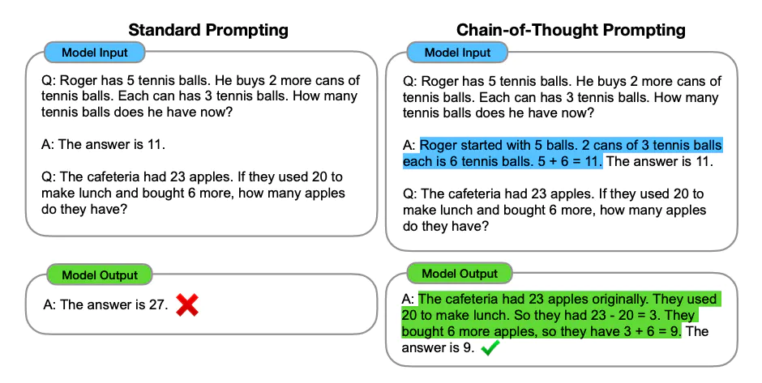
Get the LLM to show it’s work
At a high level, Chain of thought prompting (or CoT) prompting breaks apart a complicated concept into smaller pieces by showing its work
This can be triggered via few shot prompting and showing an example of it

Slide 3
Short responses are more inaccurate
Getting a short answer from an LLM is less reliable, but a longer response can get a more accurate answer.
Example:
Prompt: I went to the market and bought 10 apples. I gave 2 apples to the neighbor and 2 to the repairman. I then went and bought 5 more apples and ate 1. How many apples did I remain with?
Answer: 11 Apples ❌ This is wrong

Slide 4
Showing its work for logical reasoning
Context is a combination of the current prompt and the previous responses into building a new response from the LLM.
Example:
Q: Roger has 11 balls. He buys 2 more cans of tennis balls, each with 3 tennis balls. How many tennis balls does Roger have?
A: The answer is 17 balls
Q: The cafeteria has 23 plates. They use 20 for lunch and buy 6 more. How many plates do they have?
The A: The answer is 17 balls provides context on how the LLM should respond

Slide 5
How to give an example
If we change the format of the response in the context, it changes the way that the LLM will respond.
Example:
Q: Roger has 11 balls. He buys 2 more cans of tennis balls, each with 3 tennis balls. How many tennis balls does Roger have?
A: Roger started with 11 balls, 2 cans of tennis balls with 3 each is 6 balls. 6 + 11 = 17 balls. The answer is 17 balls
Q: The cafeteria has 23 plates. They use 20 for lunch and buy 6 more. How many plates do they have?
Now the context window has an example that the LLM can reference to show it’s work.

Slide 6
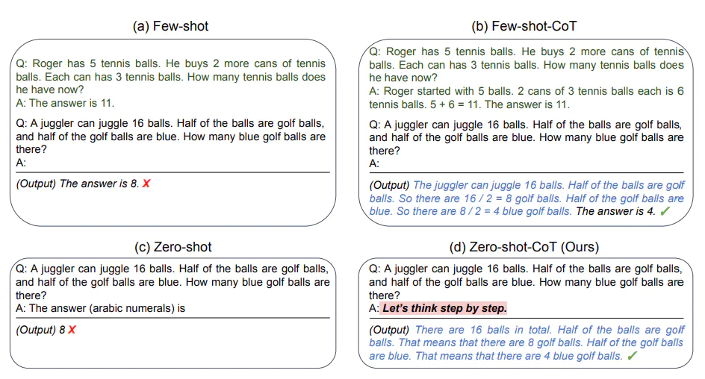
Zero shot and few shot CoT
Can trigger chain of thought prompting with Few shot and Zero Shot.
Few Shot prompting can be triggered via examples
Zero Shot can be triggered with a prompt “Let’s think step by step”

Slide 7
“Let’s think step by step”
Now lets try with a prompt that makes the LLM think
Example:
Prompt: I went to the market and bought 10 apples. I gave 2 apples to the neighbor and 2 to the repairman. I then went and bought 5 more apples and ate 1. How many apples did I remain with?
Let's think step by step.
Answer: First, you started with 10 apples.
You gave away 2 apples to the neighbor and 2 to the repairman, so you had 6 apples left.
Then you bought 5 more apples, so now you had 11 apples.
Finally, you ate 1 apple, so you would remain with 10 apples.
With chain of thought prompting, you get the right answer because the prompt leads to a longer response.

